Slide 1
A Scale and Rotation Invariant Approach to Tracking Human Body Part Regions in Videos
Yihang Bo
Hao Jiang
Institute of Automation, CAS
Boston College
Boston College

Slide 2
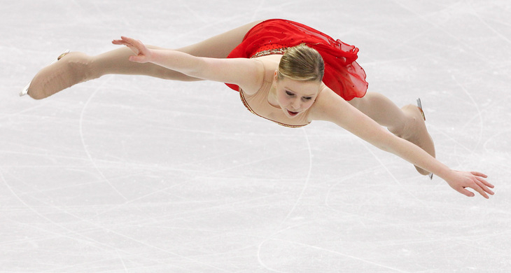
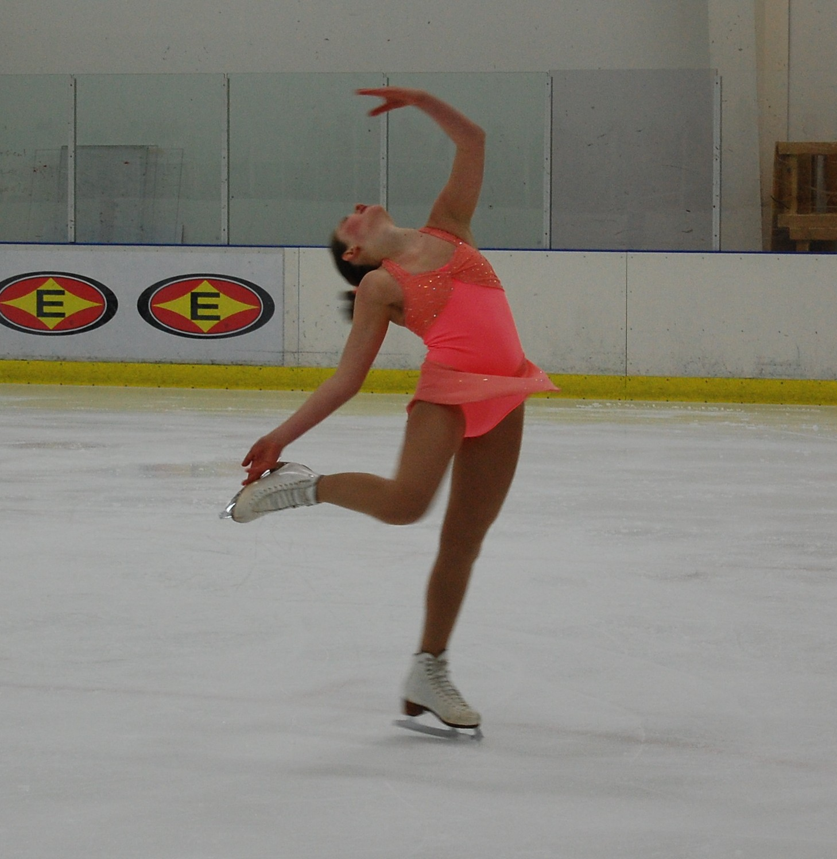
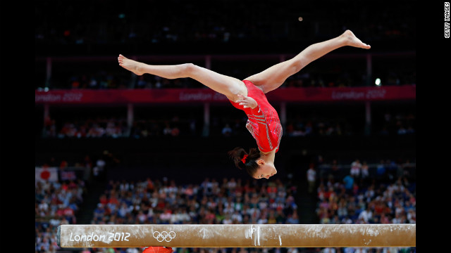
Challenges

Slide 3
Previous Rectangular Part Methods
Templates with
Different scales
Templates with
Different rotations
If the target scale and rotation are unknown, local part
extraction becomes a very slow process.

Slide 4
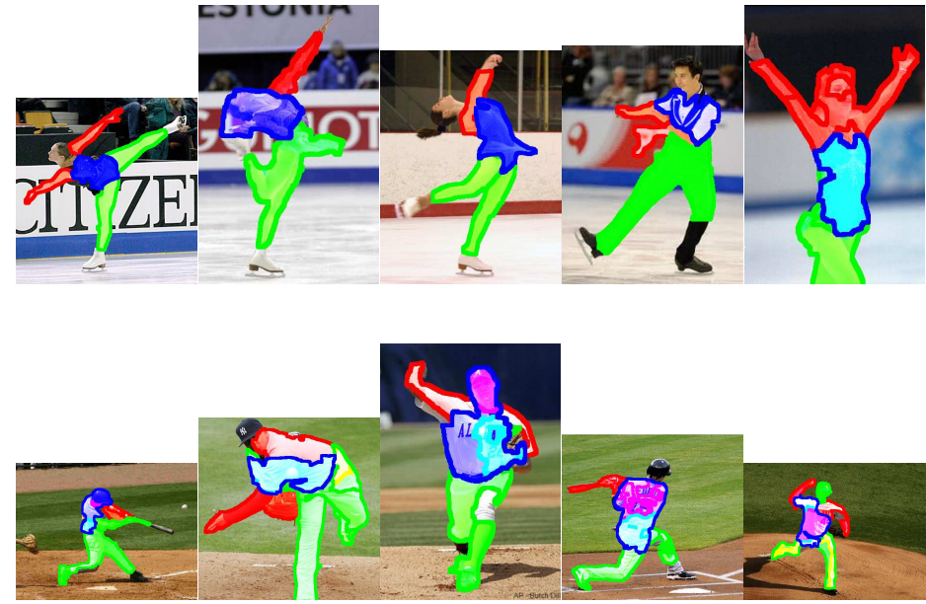
Solution: Finding Body Part Regions

Slide 5
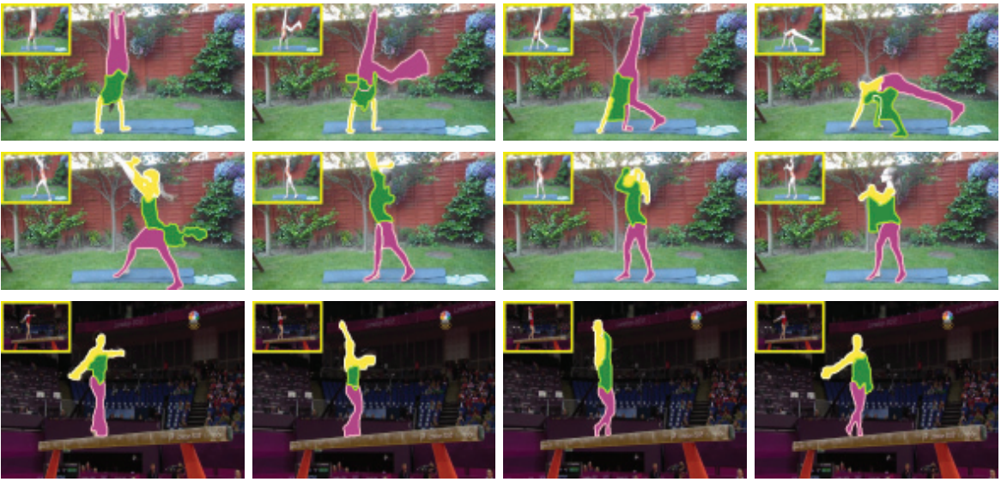
Overview of the Method
We track human body part regions (arm, leg and torso) in videos.
Our model considers spatial and temporal coupling among parts.
It is invariant to scale and rotation.

Slide 6
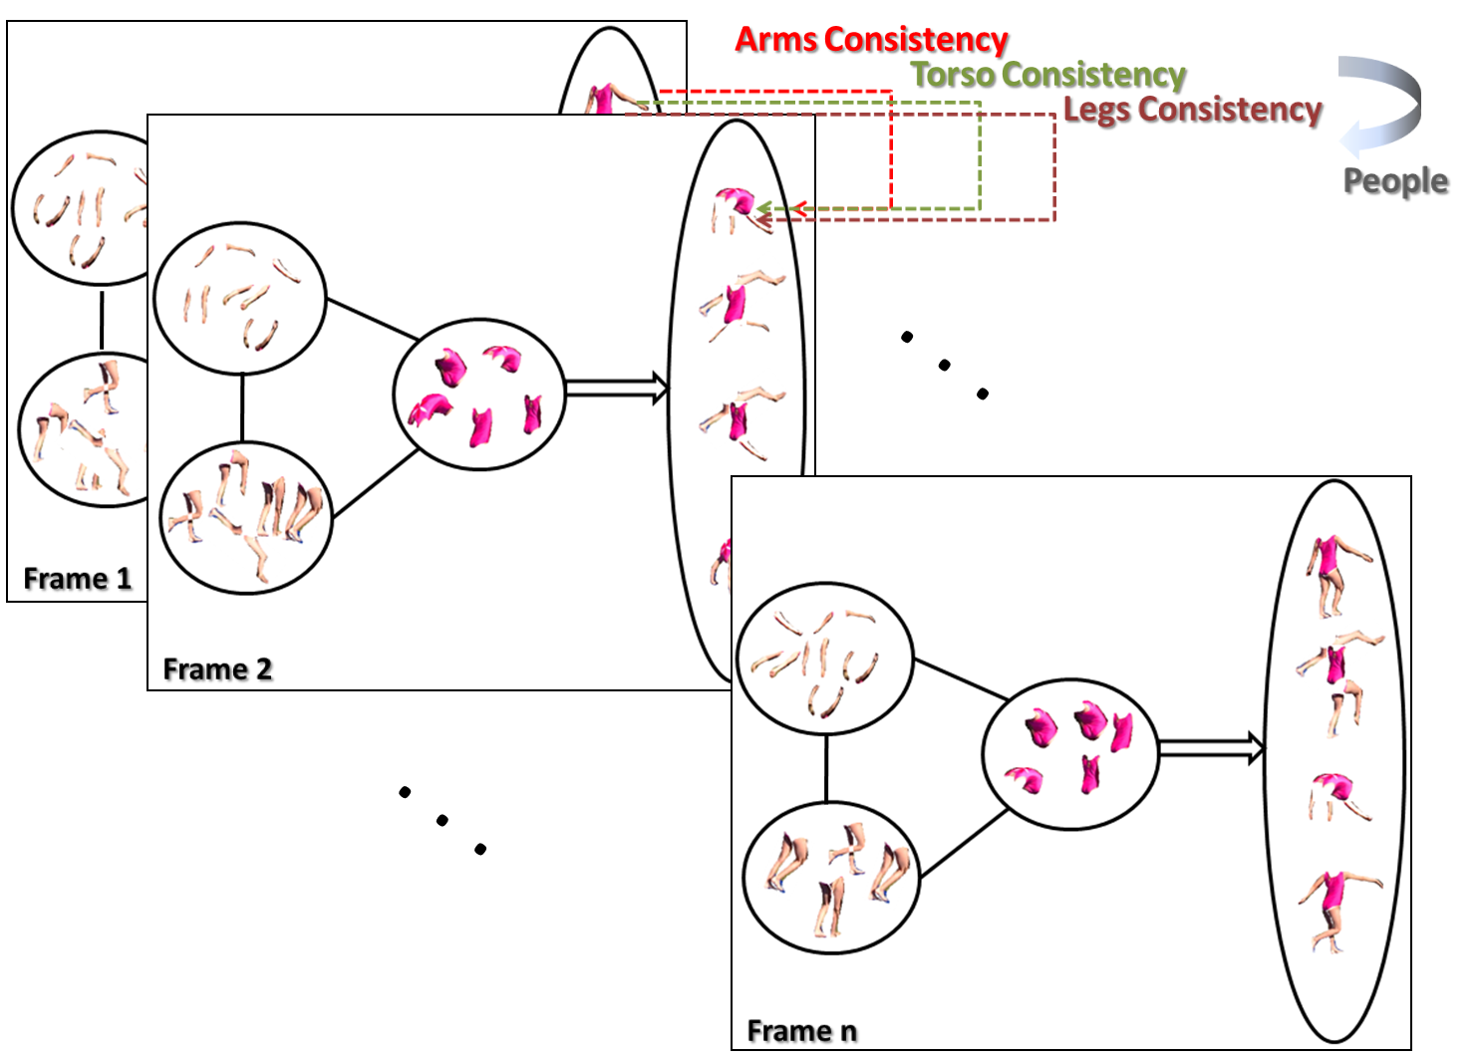
Tracking Body Part Regions

Slide 7
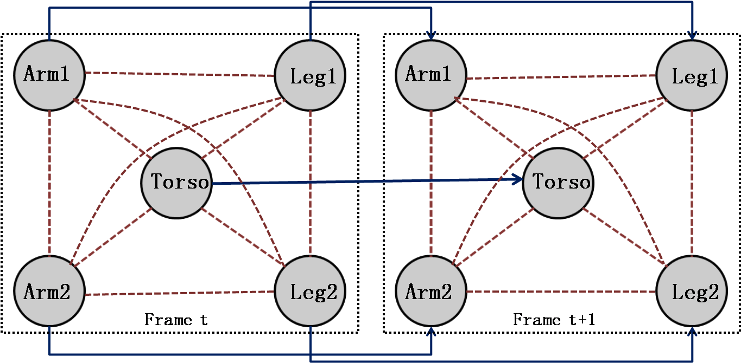
The Non-tree Model
Body part coupling between two successive video frames

Slide 8
Part Region Candidates
Superpixels
Object class independent
Region Proposals
P.F. Felzenszwalb and D.P. Huttenlocher, Efficient Graph-Based Image Segmentation
International Journal of Computer Vision, Volume 59, Number 2, September 2004.
Ian Endres, and Derek Hoiem, “Category Independent Object Proposals”, ECCV 2010.

Slide 9
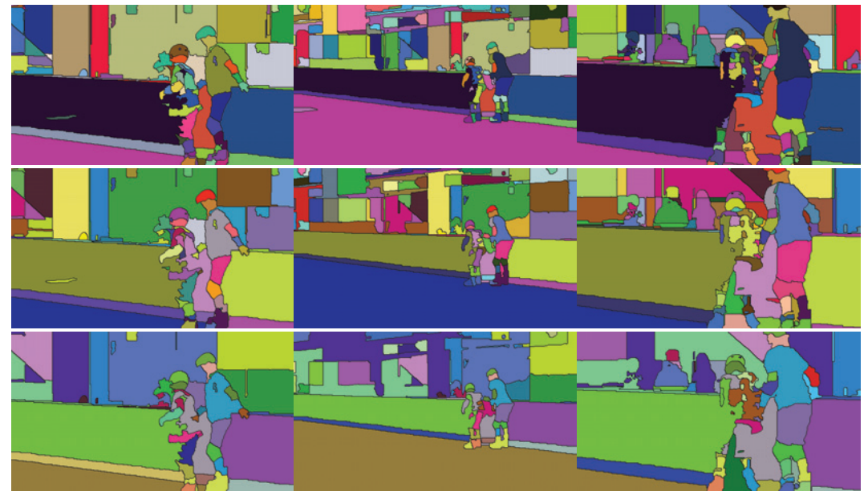
3D Superpixels
Video segmentation (3D superpixels) usually do not directly give human part regions.

Slide 10
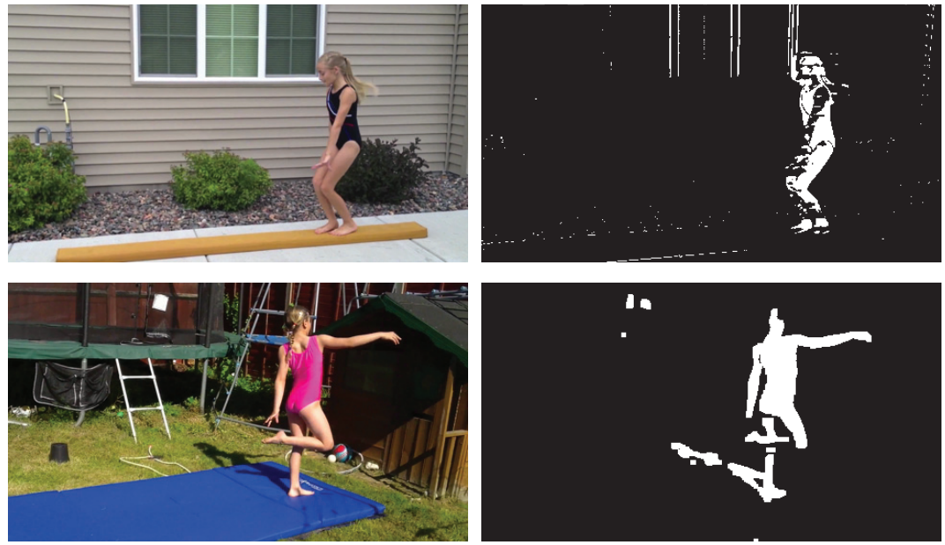
Partial Background Removal (Optional)
warping
warping
warping
warping
…
…

Slide 11
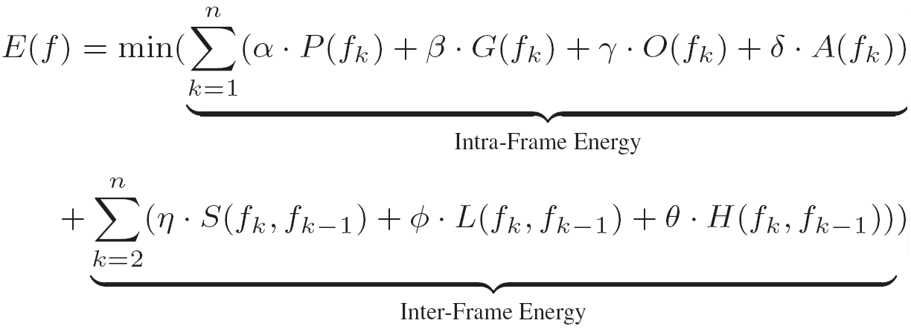
Criteria
Shape Matching
Part Distance
Part Overlap
Relative Ratio
Shape Changes
Position Changes
Appearance Changes

Slide 12
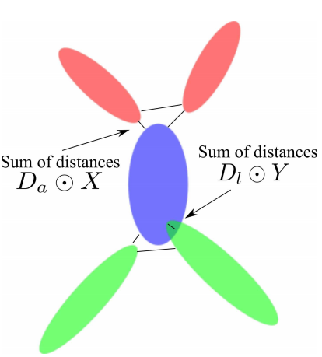
Distance Term

Slide 13
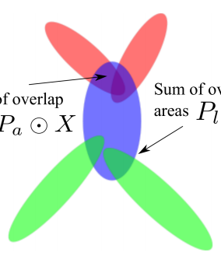
Overlap
Region
Overlap
Region
Overlap

Slide 14
Size Ratio
Part Size
Ratio

Slide 15
Shape Consistency Across Frames
Shape
Consistency

Slide 16
Motion Smoothness
Motion
Continuity

Slide 17
Color Consistency
Appearance
Consistency

Slide 18
Inference on a Loopy Graph
…
We assign region candidates to each of the body part node
so that the objective function is minimized.

Slide 19
Convert to a Chain
…
…
Linear meta-graph

Slide 20
Convert to a Chain
…
…
Unfortunately, there are too many whole body
configurations in each video frame.

Slide 21
Convert to a Chain
…
…
Solution: we find the best-N whole body configurations
in each video frame.

Slide 22
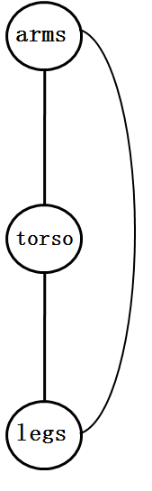
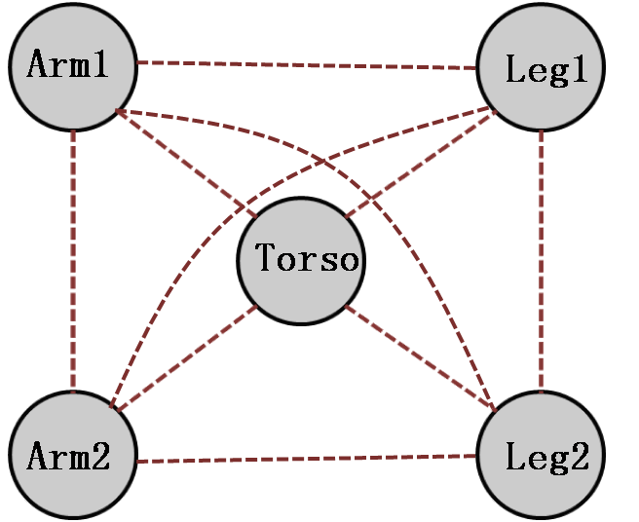
Cycle Removal

Slide 23
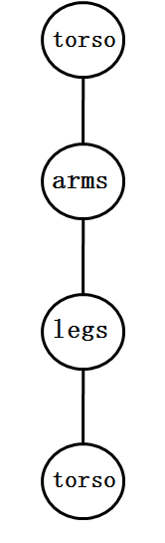
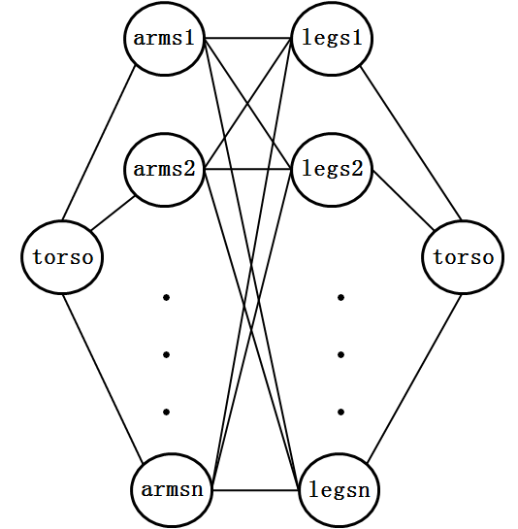
Cycle Breaking

Slide 24
Find Best-N Body Configurations on a Cycle
Best-N (with torso1)
Best-N (with torso2)
+
Best-N (with torso1,2)
Best-N (with torso3)
+
Best-N (with torso1,2,3)
…
Best-N (with torso M)
+
Best-N (with torso1..M)

Slide 25
Region Tracking on a Trellis
Best-N
Body
configurations
Frame 1
Frame 2
Frame k

Slide 26


















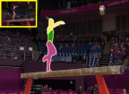
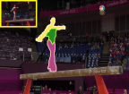
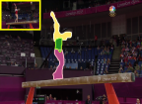
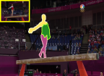
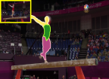
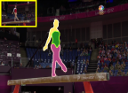
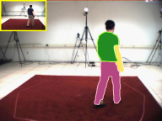
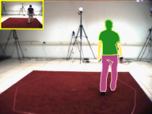
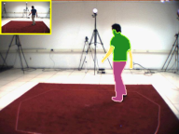
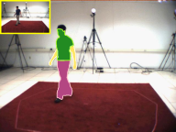
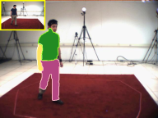
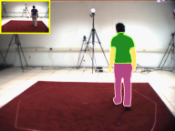
Sample Results on Five Test Videos
V1
V2
V3
V4
V5

Slide 27
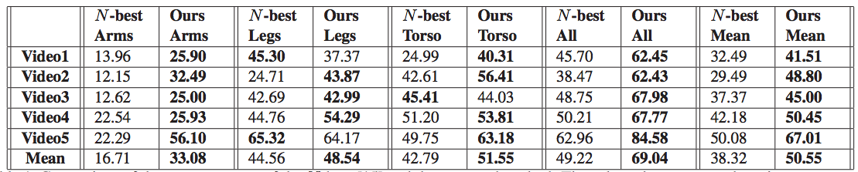
Comparison Result
[N-best] D. Park, D. Ramanan. "N-Best Maximal Decoders for Part Models”, ICCV 2011.

Slide 28
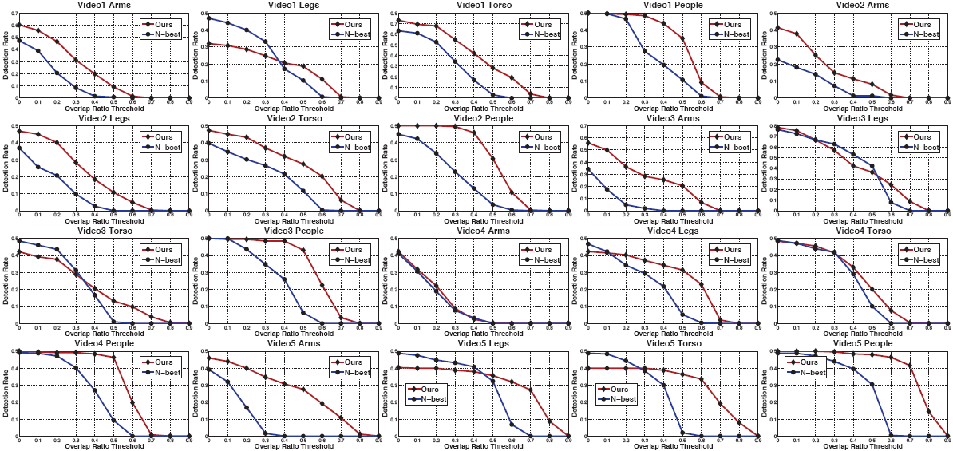
Comparison Result
Quantitative results

Slide 29
Conclusion
By tracking body part regions, we can achieve efficient scale and rotation invariant human pose tracking.
This method can be used for human tracking in complex sports videos.

Slide 30
Thank You

